Slide 1
Statistical test

Slide 2
Statistical Inference
Real world
Theoretical World
Data
Scientific model
Statistical model
Conclusions

Slide 3
Statistical Inference
Sample
Population

Slide 4
Statistical Inference
Explaination for observed difference in the data
Chance
There is something NOT right about an assumption about the theoretical world.

Slide 5
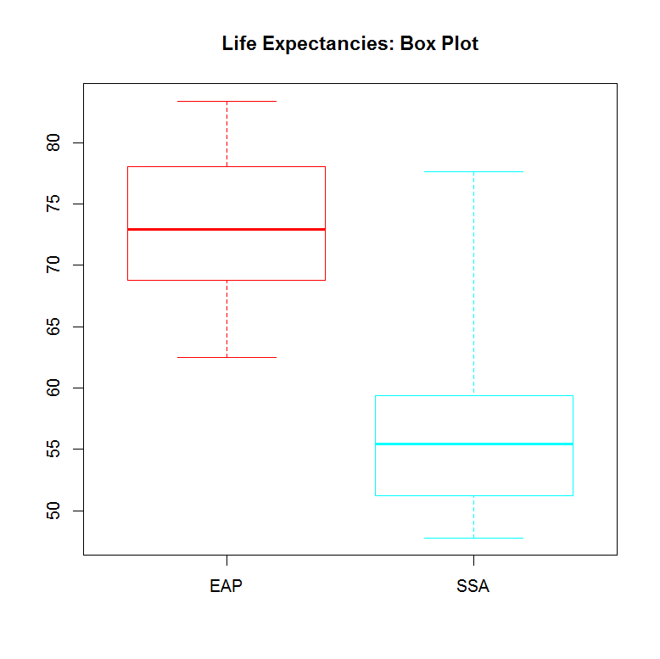
Statistical Inference
Question: Could the difference between these regions be due to the natural variability of the data?
Theoretical World:
Assume “NO Difference”
Are the data likely for the version of theoretical world?

Slide 6
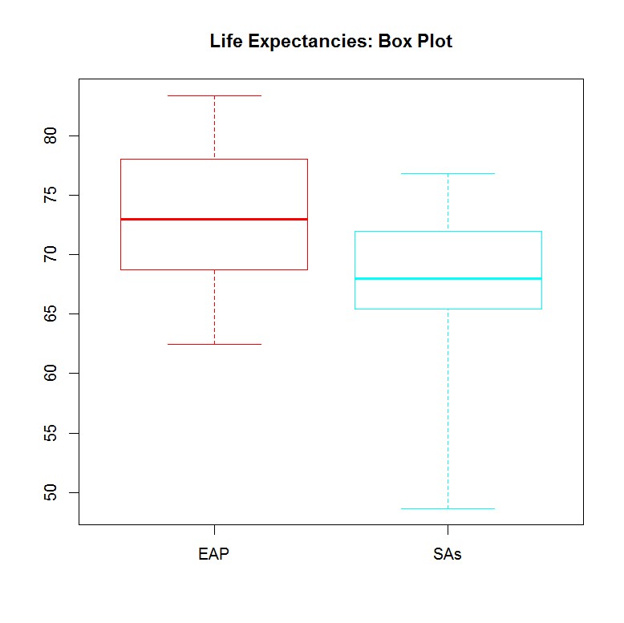
Statistical Inference
What if

Slide 7
Statistical Inference
Is a beer cap equally likely to come up on its red or silver side?
10 flips a Beer Cap, with 4 reds
1000 flips of a Beer Cap, with 576 reds
If it is 50-50, how likely is it to get value this far from half reds?

Slide 8
Statistical Inference
Data_agechange
60 patients interested in whether perceived age changes from before to after surgery
If the surgery really doesnot result in a perceived age change in average, are the data values we saw likely?
Data_TempData
Textbook: mean body temperature is 37 degree
The data shows mean body temperature is 36.8 degree
Is it significant difference?
Does the theoretical result need updating?
Not if this difference can be explained by random variation

Slide 9
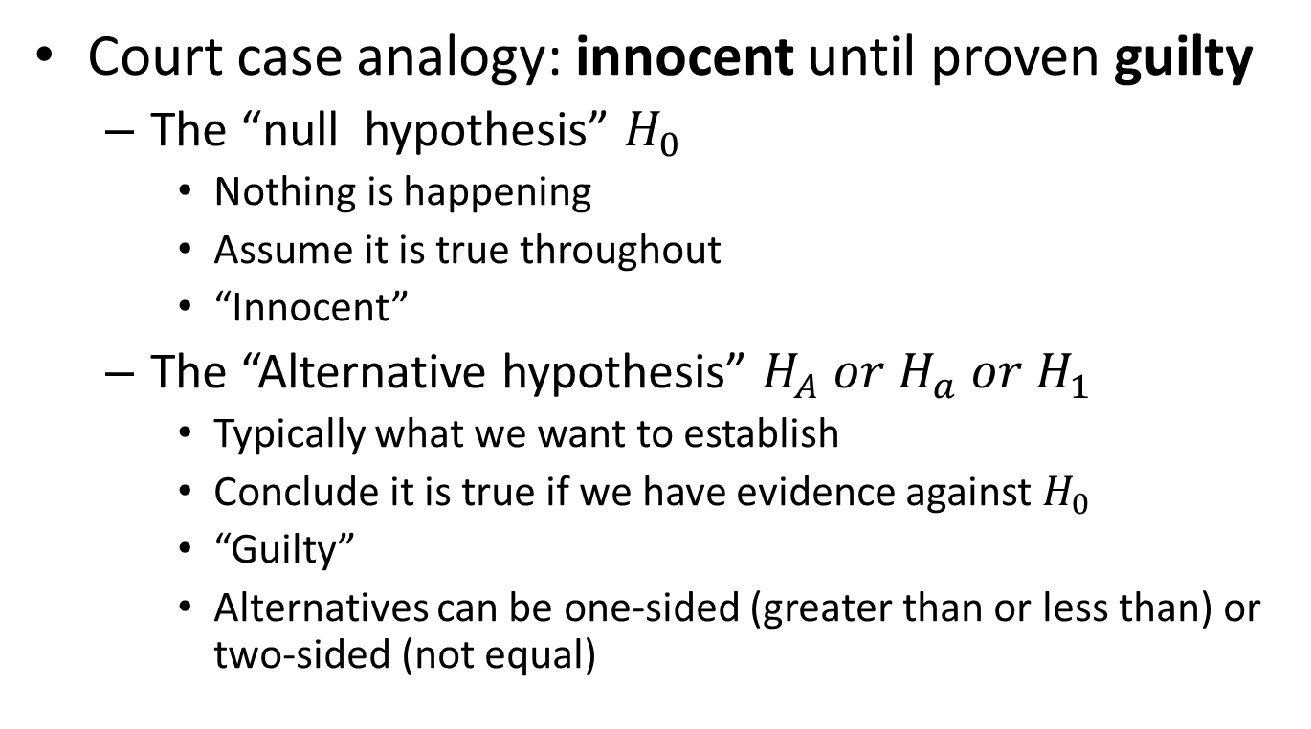
Statistical Tests – step 1
Court case analogy: innocent until proven guilty
The “null hypothesis” $H_{0}$
Nothing is happening
Assume it is true throughout
“Innocent”
The “Alternative hypothesis” $H_{A} or H_{a} or H_{1}$
Typically what we want to establish
Conclude it is true if we have evidence against $H_{0}$
“Guilty”
Alternatives can be one-sided (greater than or less than) or two-sided (not equal)

Slide 10
Statistical Tests – step 1
Step 1:
Determine the null hypothesis and the alternative hypothesis

Slide 11
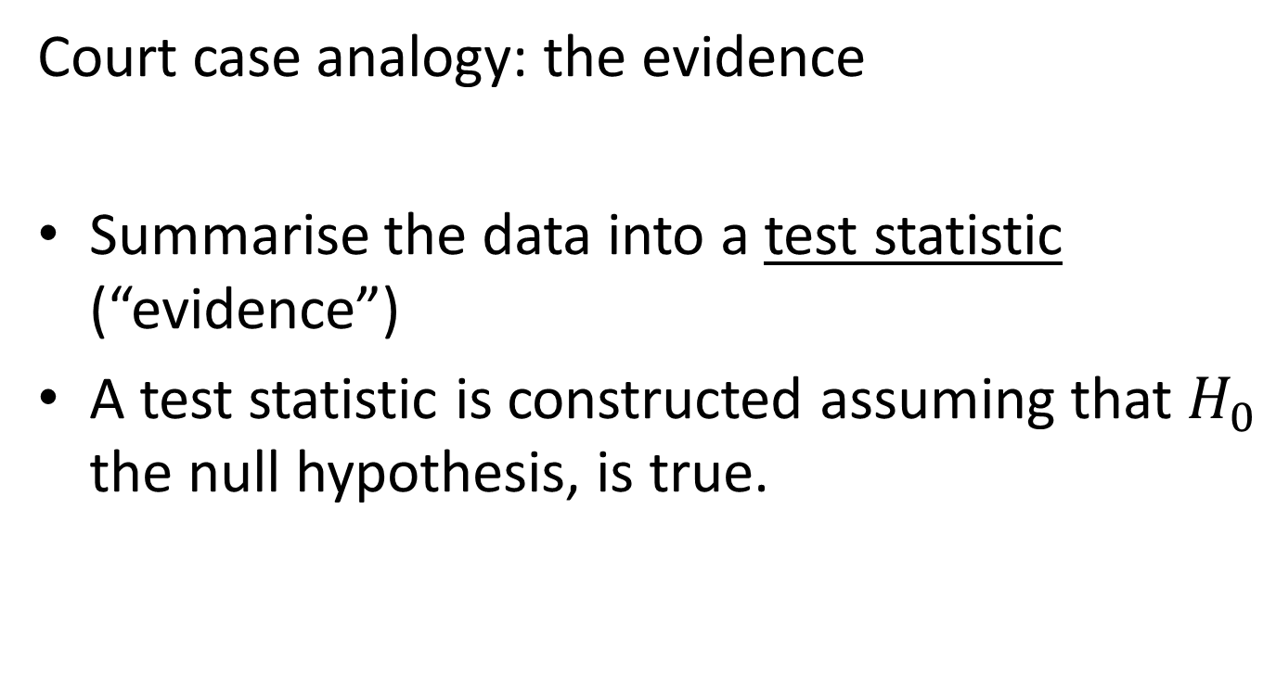
Statistical Tests – step 2
Court case analogy: the evidence
Summarise the data into a test statistic (“evidence”)
A test statistic is constructed assuming that $H_{0}$ the null hypothesis, is true.

Slide 12
Statistical Tests – step 2
Step 2
Collect the data and calculate a test statistic.

Slide 13
Statistical Tests – step 3
Court case analogy: the deliberations (beyond a reasonable doubt?)
Calculate p-value
A p-value is a number between 0 and 1 that quantifies the strength of difference against the null hypothesis
The p-value is the probability that the data would be at least as extreme as those observed if the null hypothesis were true.

Slide 14
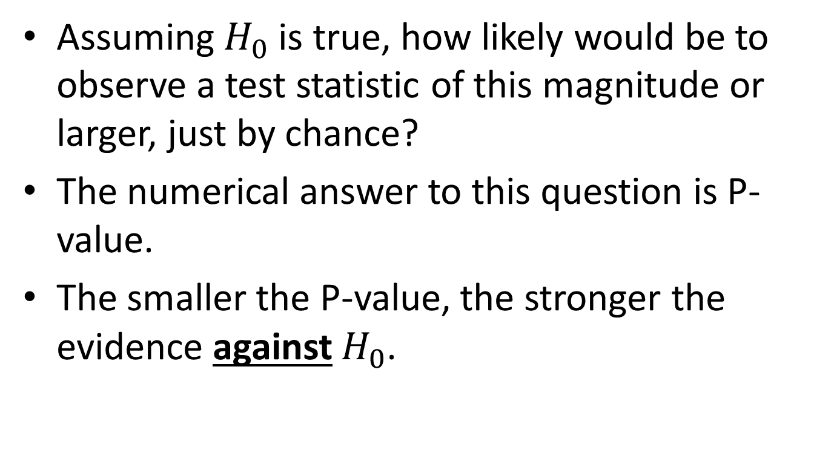
Statistical Tests – step 3
Assuming $H_{0}$ is true, how likely would be to observe a test statistic of this magnitude or larger, just by chance?
The numerical answer to this question is P-value.
The smaller the P-value, the stronger the evidence against $H_{0}$.

Slide 15
Statistical Tests – step 3
What a P-value does not tell you:
How likely it is that the null hypothesis is true.
What a P-value does tell you:
How likely the observed data would be if the null hypothesis were true.

Slide 16
Statistical Tests – step 3
Step 3
Determine how unlikely the test statistic is if the null hypothesis is true. This is the P-value.

Slide 17
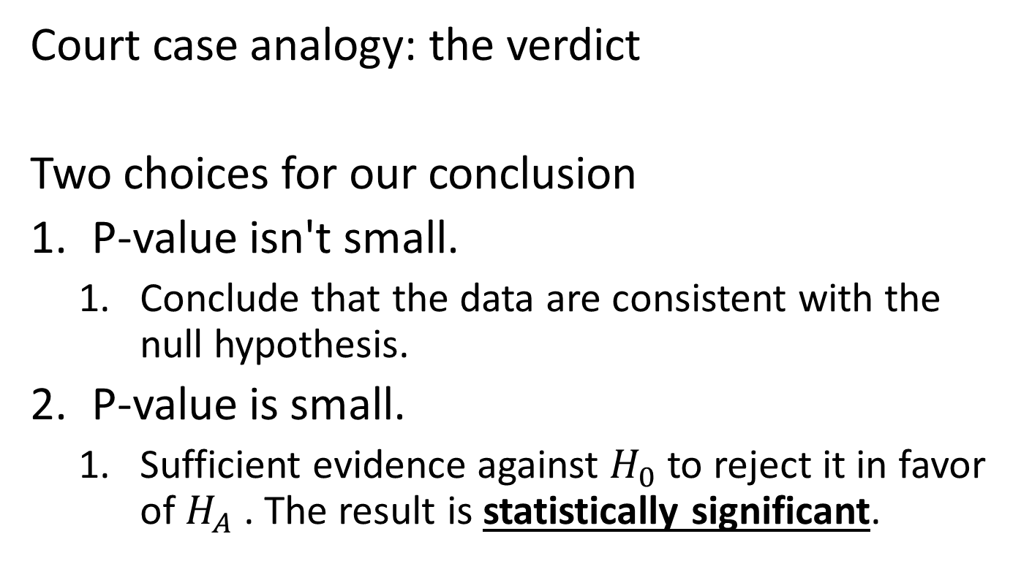
Statistical Tests – step 4
Court case analogy: the verdict
Two choices for our conclusion
P-value isn't small.
Conclude that the data are consistent with the null hypothesis.
P-value is small.
Sufficient evidence against $H_{0}$ to reject it in favor of $H_{A}$ . The result is statistically significant.

Slide 18
Statistical Tests – step 4
Guideline for how small is small:
P-Value | Strength of evidence against the null hypothesis
P-Value < 0.001 | Very strong
0.001 < P-Value < 0.01 | Strong
0.01 < P-Value < 0.05 | Moderate
0.05 < P-Value < 0.1 | Weak
P-Value > 0.1 | None

Slide 19
Statistical Tests – step 4
Step 4
Make a conclusion based on the P-value and the context of the problem.

Slide 20
The Structure of Statistical Tests
Step 1: Determine the null hypothesis and the alternative hypothesis
Step 2: Collect the data and calculate a test statistic.
Step 3: Determine how unlikely the test statistic is if the null hypothesis is true. This is the P-value.
Step 4: Make a conclusion based on the P-value and the context of the problem.

Slide 21
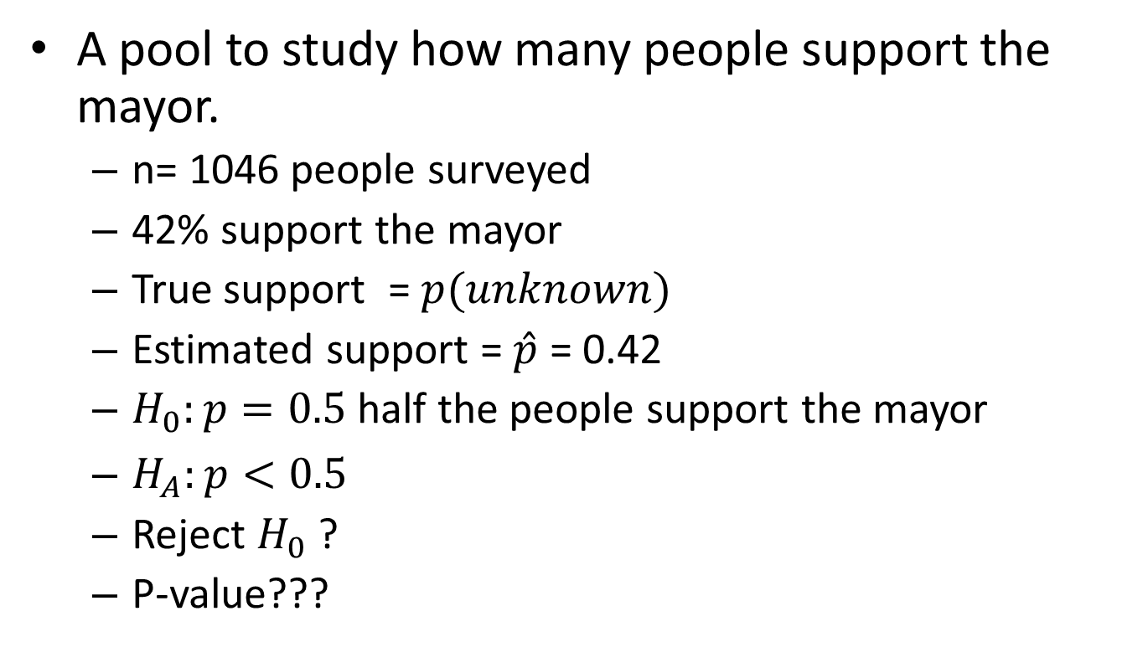
Hypothesis Testing for Proportions
A pool to study how many people support the mayor.
n= 1046 people surveyed
42% support the mayor
True support = $p(unknown)$
Estimated support = $\hat{p}$ = 0.42
$H_{0}:p=0.5$ half the people support the mayor
$H_{A}:p<0.5$
Reject $H_{0}$ ?
P-value???

Slide 22
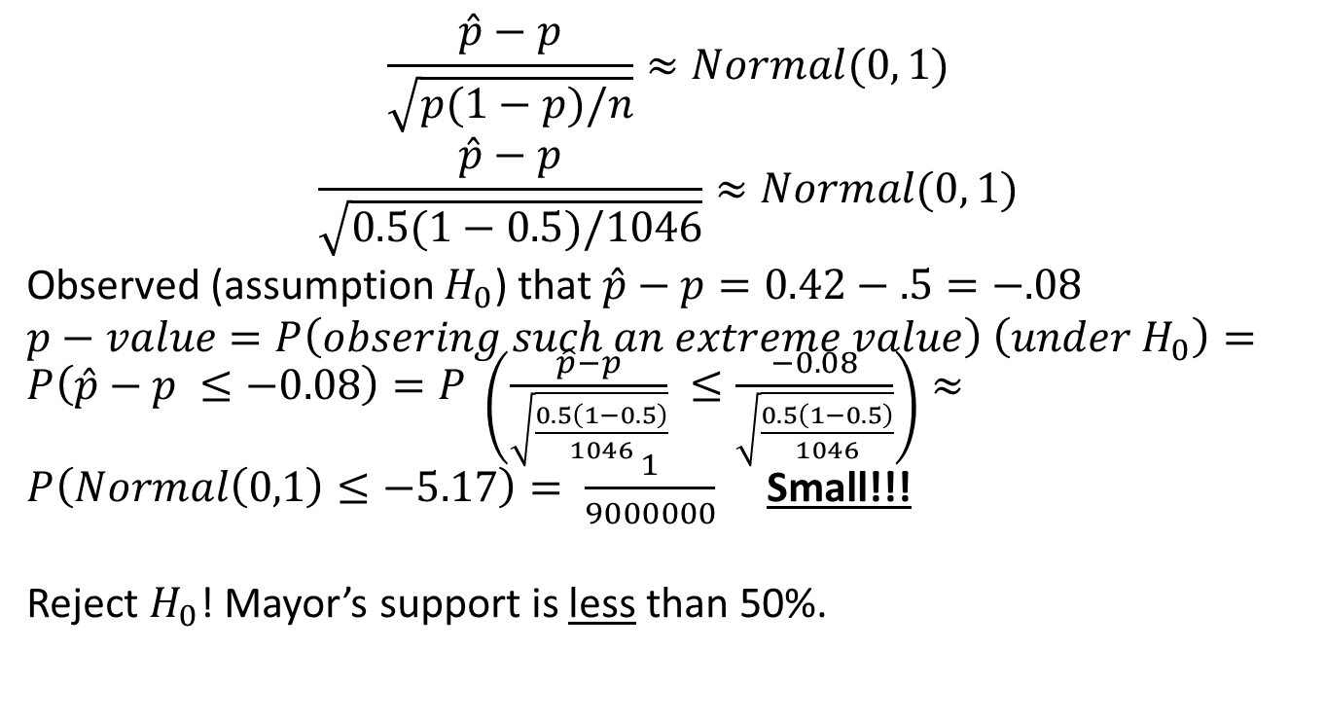
Theoretical World
$$\frac{\hat{p}−p}{\sqrt{p(1−p)/n}}≈Normal(0, 1)$$
$$\frac{\hat{p}−p}{\sqrt{0.5(1−0.5)/1046}}≈Normal(0, 1)$$
Observed (assumption $H_{0}$) that $\hat{p}−p=0.42−.5=−.08$
$p−value=P\left(obsering such an extreme value\right) \left(under H_{0}\right)=P\left(\hat{p}−p ≤−0.08\right)=P \left(\frac{\hat{p}−p}{\sqrt{\frac{0.5\left(1−0.5\right)}{1046}}} ≤\frac{−0.08}{\sqrt{\frac{0.5\left(1−0.5\right)}{1046}}}\right)≈P\left(Normal\left(0,1\right)≤−5.17\right)= \frac{1}{9000000}$ Small!!!
Reject $H_{0}$! Mayor’s support is less than 50%.

Slide 23
R-code
test.stat = (0.42-0.5) / sqrt(0.5*0.5/1046)
test.stat
pnorm(test.stat, mean=0, sd=1, lower.tail=TRUE)
x = round(0.42*1046, 0)
x
binom.test(x, 1046, p=0.5, alternative='less')
binom.test(576, 1000, p=0.5, alternative='two.sided')

Slide 24
Practice
What if we assume mayor’s support is 44%?
What is the conclusion?
For the beer cap case
H0: p=0.5; HA !=0.5 (two sided)

Slide 25
Hypothesis test for mean
Example: plastic surgery
Data: n=60;
Observations: number of years they looks younger
Mean = 7.177; s = 2.948
True mean is unknown
H0: mean is 0; HA: mean is not zero.

Slide 26

Hypothesis test for mean
Theoretical world
$$\frac{\overline{X}−μ}{\sqrt{s^{2}/n}}≈t_{n−1}$$
t distribution with n-1 degree of freedom

Slide 27
R-code
agechange = read.table('agechange.txt')
change = agechange$V1
xbar = mean(change)
s2 = var(change)
n = length(change)
t = (xbar - 0) / sqrt(s2/n)
t
pt(t, df=n-1, lower.tail=F)
What is the conclusion?

Slide 28
Practice
Skeleton data
N=400
Mean =-14.15 years; SD = 14.13 years
H0 = mean is zero; HA: mean is not zero (two -sides)

Slide 29
Practice
Temperature
N=130
Mean = 36.80
Sd = 0.407324
H0 mean is 37
HA mean is not 37 two-sided

Slide 30
R-code
bodytemp = read.table('TempData.txt')
temp = bodytemp$V1
t.test(temp, mu=37, alternative='two.sided')

Slide 31
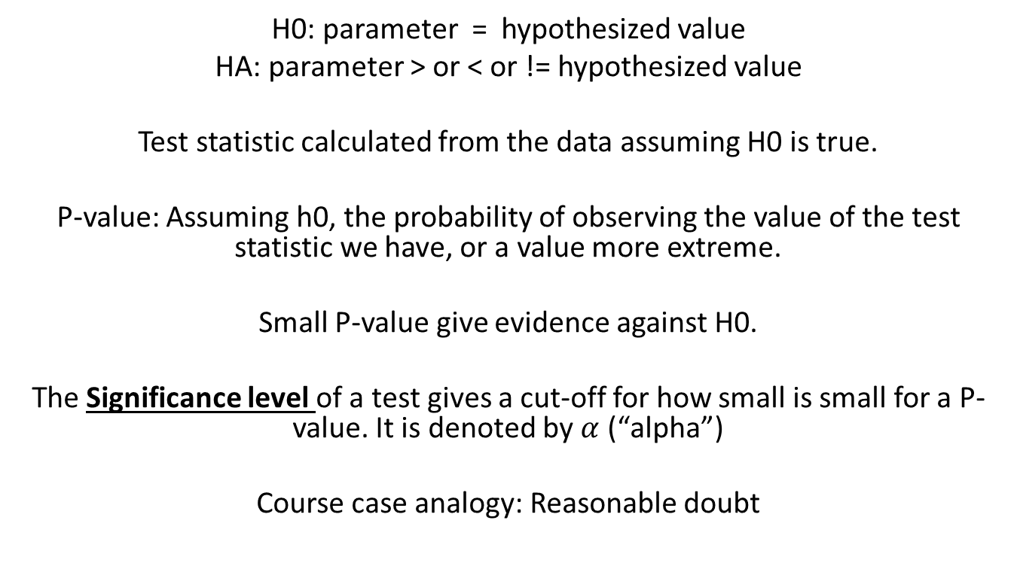
Statistical Tests
H0: parameter = hypothesized value
HA: parameter > or < or != hypothesized value
Test statistic calculated from the data assuming H0 is true.
P-value: Assuming h0, the probability of observing the value of the test statistic we have, or a value more extreme.
Small P-value give evidence against H0.
The Significance level of a test gives a cut-off for how small is small for a P-value. It is denoted by $α$ (“alpha”)
Course case analogy: Reasonable doubt

Slide 32
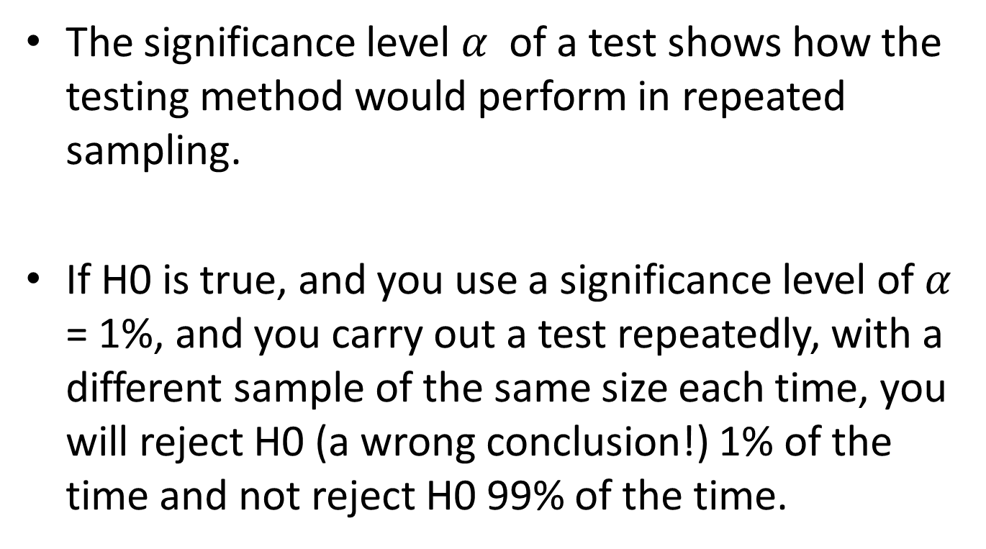
Power of a Test
The significance level $α$ of a test shows how the testing method would perform in repeated sampling.
If H0 is true, and you use a significance level of $α$ = 1%, and you carry out a test repeatedly, with a different sample of the same size each time, you will reject H0 (a wrong conclusion!) 1% of the time and not reject H0 99% of the time.

Slide 33
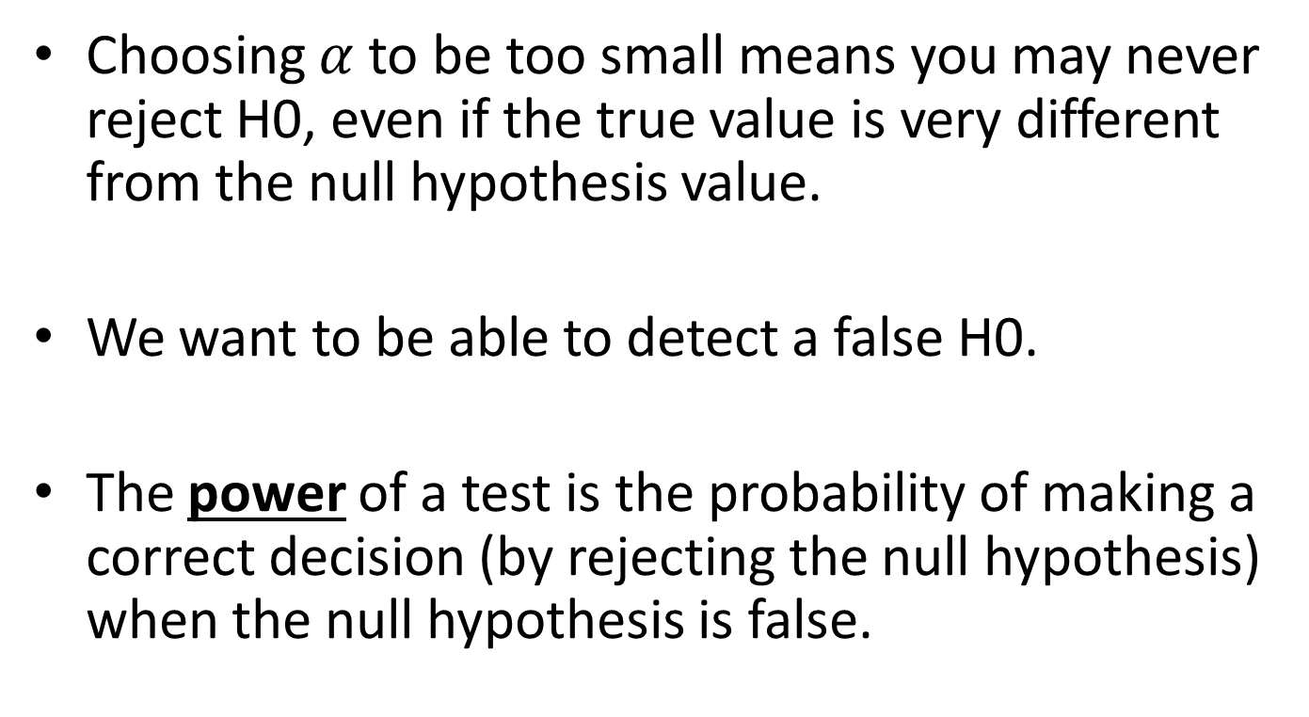
Power of a test
Choosing $α$ to be too small means you may never reject H0, even if the true value is very different from the null hypothesis value.
We want to be able to detect a false H0.
The power of a test is the probability of making a correct decision (by rejecting the null hypothesis) when the null hypothesis is false.

Slide 34
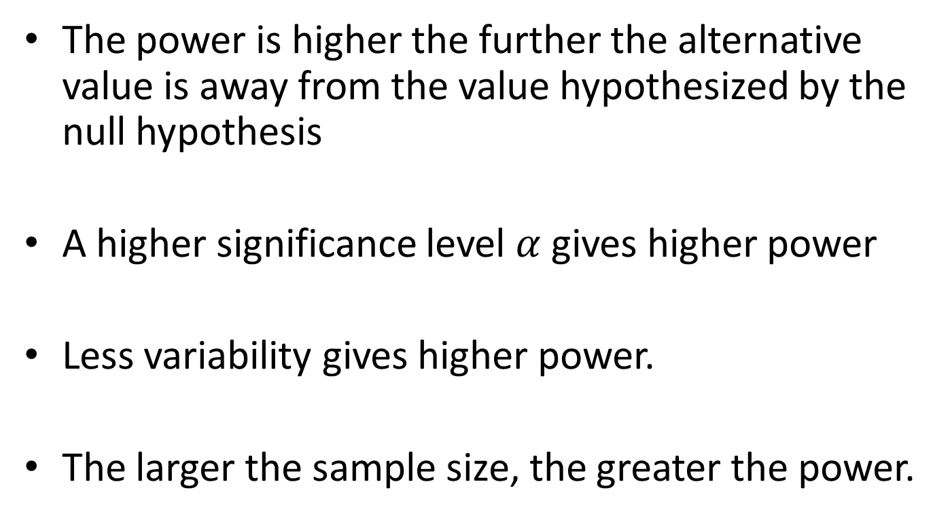
How to have higher power
The power is higher the further the alternative value is away from the value hypothesized by the null hypothesis
A higher significance level $α$ gives higher power
Less variability gives higher power.
The larger the sample size, the greater the power.

Slide 35
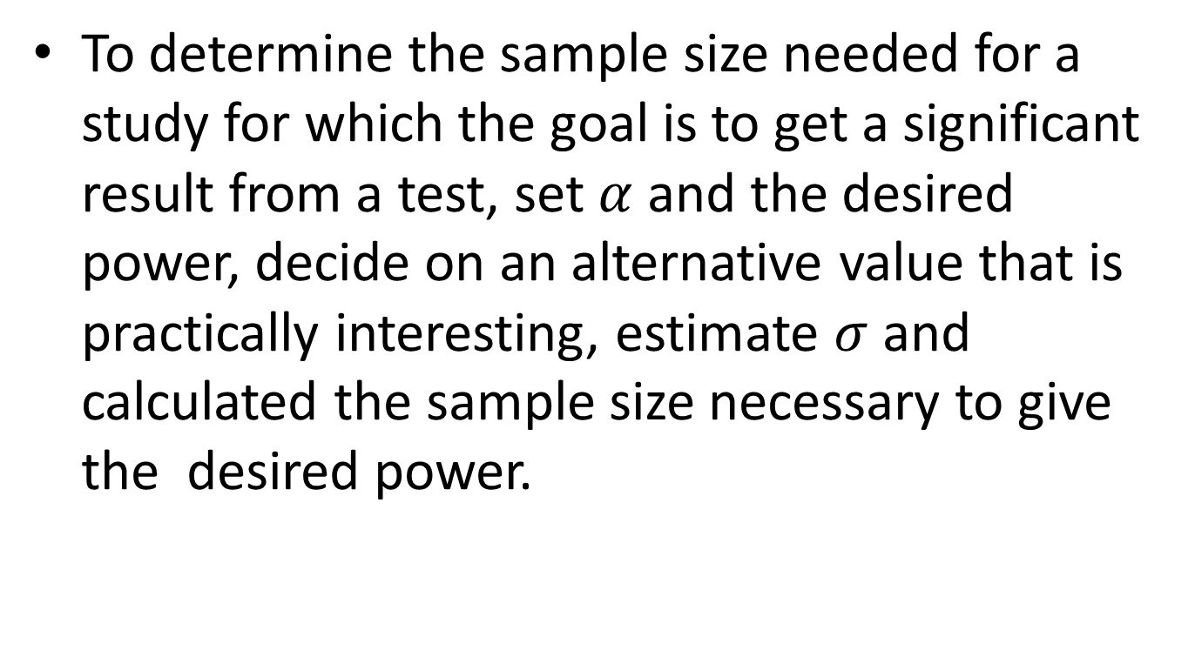
How to have a high power
To determine the sample size needed for a study for which the goal is to get a significant result from a test, set $α$ and the desired power, decide on an alternative value that is practically interesting, estimate $σ$ and calculated the sample size necessary to give the desired power.

Slide 36
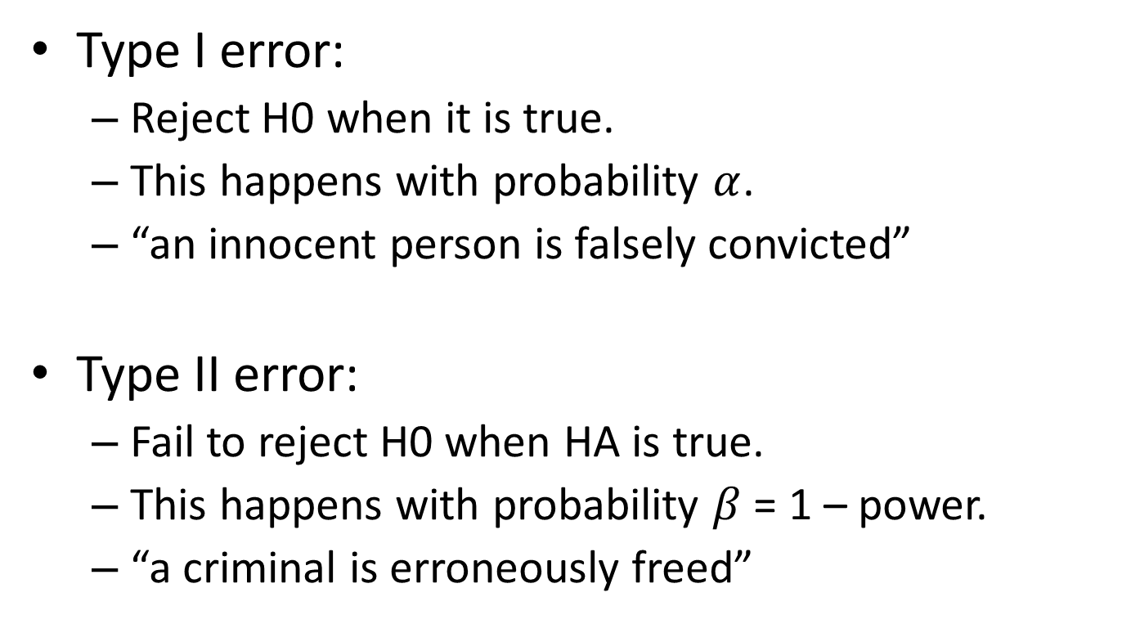
Two Types of Errors
Type I error:
Reject H0 when it is true.
This happens with probability $α$.
“an innocent person is falsely convicted”
Type II error:
Fail to reject H0 when HA is true.
This happens with probability $β$ = 1 – power.
“a criminal is erroneously freed”

Slide 37
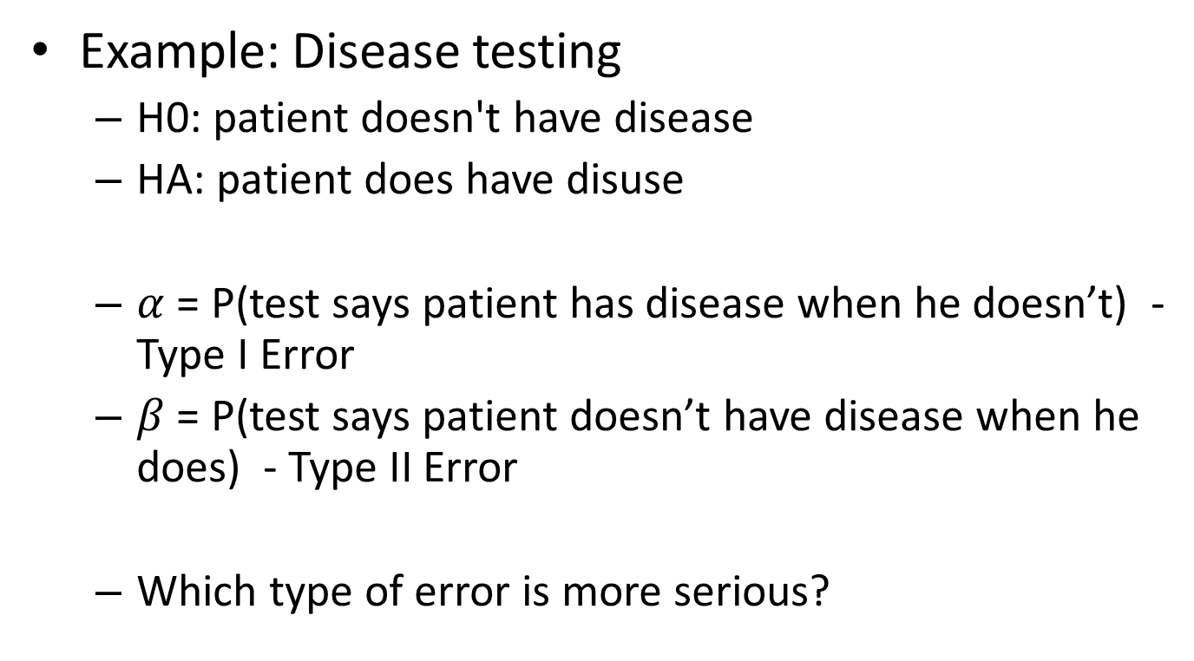
Two Types of Errors
Example: Disease testing
H0: patient doesn't have disease
HA: patient does have disuse
$α$ = P(test says patient has disease when he doesn’t) - Type I Error
$β$ = P(test says patient doesn’t have disease when he does) - Type II Error
Which type of error is more serious?

Slide 38
Some tips
Don’t misinterpret P-values.
What a P-value does not tell you:
How likely it is that the null hypothesis is true.
What a P-value does tell you:
How likely the observed data would be if the null hypothesis is true.
A P-value is a measure of the strength of the evidence, so report your P-values.
There was a statistically significant difference.

Slide 39
Some tips
Testing cannot correct flaws in the design of data collection.
Lack of randomization in choosing a sample
Lack of control
Lack of randomization in assigning treatments
May cause
Bias
Confounding
Inability to make causal conclusion

Slide 40
Some tips
Always use 2-sided tests.
(unless you are sure that one direction is no interest)
P-value(1-sided) = half of P-value(2-sided)

Slide 41
Some tips
Statistical significance is not the same thing as practical significance.
Example: beer cap flips. H0: p=0.5; HA: p != 0.5
Experiments
6 reds / 10 flips
58 reds /100 flips
576 reds /1000 flips
Q: What is the P-value for each experiment?

Slide 42
Some tips
A large P-value does not necessarily mean that the null hypothesis is true. There may not be enough power to reject it.

Slide 43
Some tips
Small P-values may occur
By chance
Because of problems related to data collection.
Because of violations of the conditions necessary for the particular testing procedure being used.
Because the null hypothesis is false.

Slide 44
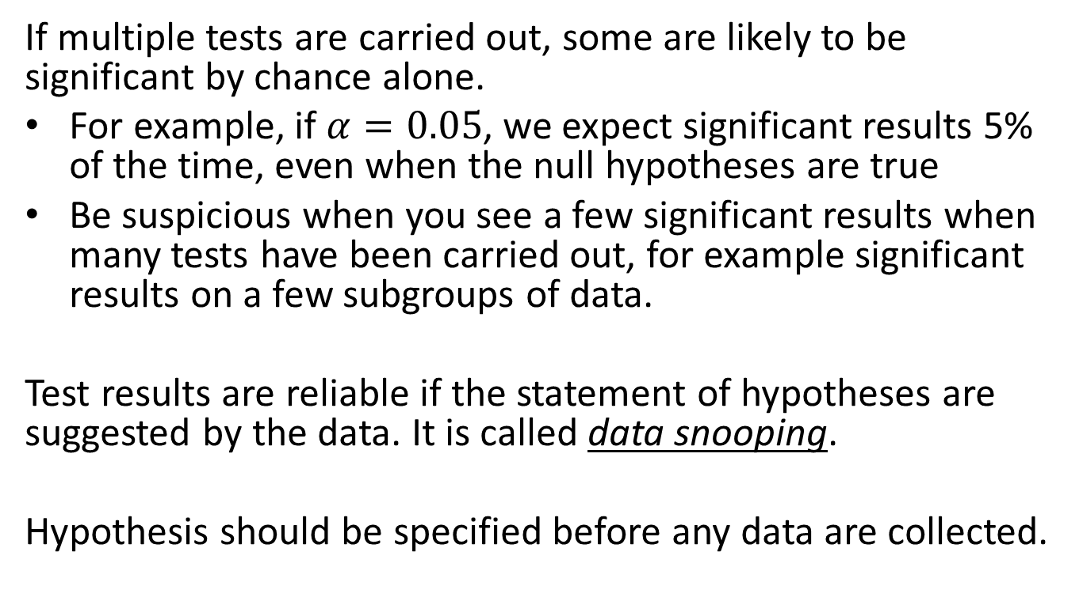
Some Tips
If multiple tests are carried out, some are likely to be significant by chance alone.
For example, if $α=0.05$, we expect significant results 5% of the time, even when the null hypotheses are true
Be suspicious when you see a few significant results when many tests have been carried out, for example significant results on a few subgroups of data.
Test results are reliable if the statement of hypotheses are suggested by the data. It is called data snooping.
Hypothesis should be specified before any data are collected.

Slide 45
Some tips
The tests we have learned for proportions and means require:
Independent observations;
The sampling distributions of the estimators to be (approximately) normal distributed.
A statistical test is robust if the P-value is approximately correct, even if the necessary conditions aren't completely satisfied.

Slide 46
Some Tips
For tests of proportions, larger sample sizes are needed for the further the true value of p is from 0.5.
For tests of means, the t-test is robust, even for small sizes, except when there is extreme skew or outliers.

Slide 47
Some tips
Statistical test should start with exploratory analyses using plots and summary statistics.
Testing cannot correct flaws in data collection.
Statistical tests work well when applied to carefully designed studies when planned, focused hypotheses to investigate.

